Slide 1
Microchip’s Academic Program

Slide 2
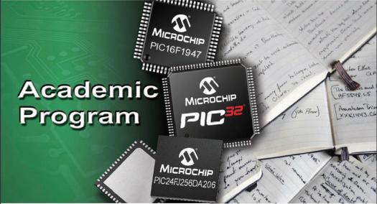
Our Mission
“Facilitate the integration of Microchip products and technologies into the classroom”
Notes:
2
2

Slide 3
How do we do this?

Slide 4
How do we do this?
Access to labs, curriculum and course material
Silicon donations to help seed labs
Assistance in finding low-cost tools
25% Academic Discount when ordering tools through www.microchipdirect.com

Slide 5


Keeping Academics Informed
Quarterly Newsletter
  Articles from Students
  Third Parties
  New products and technologies
  www.microchip.com/academicnewsletter
MCHP Tube
  Online newscast with Academic Focus
  Latest news on new products and technologies:
    Microchip and Third Parties
  Forum to interact directly with Microchip staff
  www.microchip.com/mchptube
Microchip

Slide 6
Training and Curriculum Support
Free training at any of our worldwide Regional Training Centers (RTC) for Academic Partners
www.microchip.com/rtc
RTC course materials are available for Academic use:
  Includes presentations, labs, manuals and solutions
  Courses available on all Microchip architectures
  Technology specific classes available
We’re just an email away to help point you to existing, online resources and documentation
Academic@microchip.com

Slide 7
Diverse Variety of Low-Cost Development Tools

Slide 8



Software Solutions for all Levels
®
MPLAB X
Integrated Development Environment (IDE)
Assembly
Programming
MPASM
Assembler
FREE
MPSIM
Simulator
www.microchip.com/mplab

Slide 9
Software Solutions for all Levels
®
MPLAB X
Integrated Development Environment (IDE)
Assembly
Programming
C
Programming
FREE Versions available
MPASM
Assembler
MPLAB
xc
Cross platform with
no time-outs or code-size restrictions
MPSIM
Simulator
Compilers
www.microchip.com/mplabxc

Slide 10
Software Solutions for all Levels
®
MPLAB X
Integrated Development Environment (IDE)
Assembly
Programming
C
Programming
BASIC
MPASM
Assembler
Third-Party
BASIC
Compilers
MPLAB
xc
MPSIM
Simulator
Compilers

Slide 11

Software Solutions for all Levels
®
MPLAB X
Integrated Development Environment (IDE)
Assembly
Programming
C
Programming
BASIC
Visual
Programming
MPASM
Assembler
Third-Party
BASIC
Compilers
Simulink®
Blocksets for
dsPIC®
MPLAB
xc
MPSIM
Simulator
Compilers
FREE
www.microchip.com/dspicblocksets

Slide 12
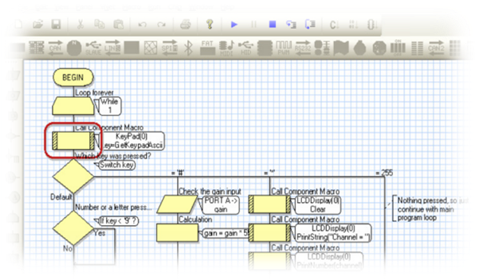
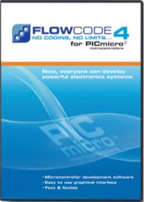

Flowcode Graphical Programming Environment
Supports PIC12, PIC16, PIC18 MCUs
New 16-bit version supports PIC24 MCUs and dsPIC DSCs

Slide 13
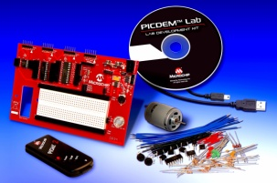
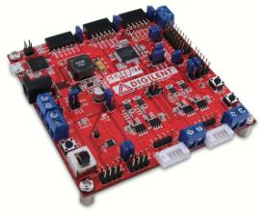
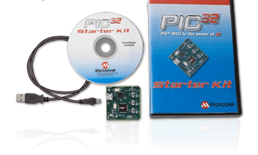
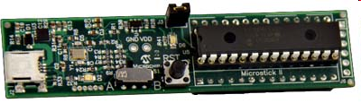
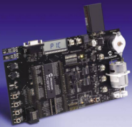
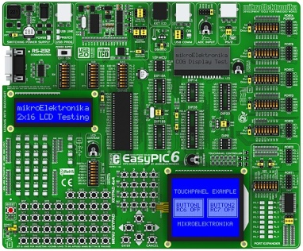
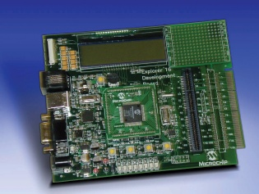
Academic Friendly Hardware (Microchip and Third Party)

Slide 14

Academic Friendly Hardware (Microchip and Third Party)
25% Academic Discount on many Tools Available Through

Slide 15
Development Tool Highlights

Slide 16
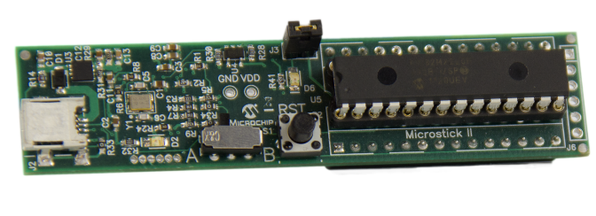
New Microstick Platforms
Integrated programmer/debugger
DUT Socket for easy device swapping
Plugs into prototyping areas using 0.025” headers
Microstick II supports 3.3V PIC24FJ, PIC24H, dsPIC33 and PIC32 in SPDIP
Microstick for 3V PIC24F K-series now available
$34.95USD on mD

Slide 17
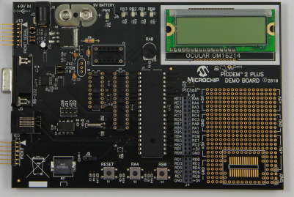
PICDEM™2 PLUS
Upgrades to this popular Academic platform
  Support for newer 8-bit devices
  Adds PICkit™ 3 and PICkit™ Serial Connectivity
  Source files in now provided in C Language
    Existing ASM files still available
  $99.99USD on mD

Slide 18
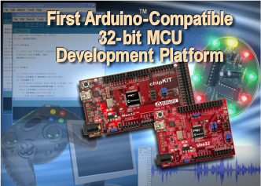


chipKIT™ Boards for the Arduino Community
Uses modified version of Arduino™ IDE
  Adds MCU Support
  Leverage existing resources
Higher performance at a lower cost
Pin-out compatible with many existing 3.3V shields

Slide 19
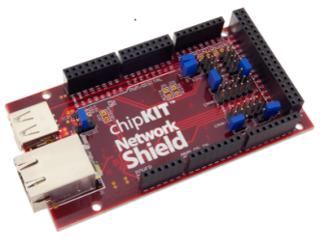




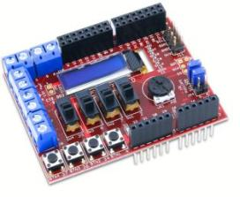
New shields Highlight Additional Functionality
chipKIT Network Shield:
  Circuitry and connectors for advanced communications
chipKIT Basic I/O shield:
  Input/output expansion board
chipKIT™ Network Shield
chipKIT™ Basic I/O Shield

Slide 20
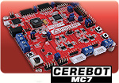
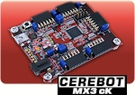
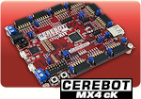
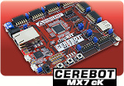
Cerebot Boards
Cerebot MC7 –Advanced motor control board
  dsPIC33FJ128MC706A
  8 x Servo Motor connectors
  Perfect controller for BDC, BLDC, and Stepper Motors
  $119 USD on mD
Cerebot cK Platforms
  PIC32 Development compatible with both chipKIT™ and MPLAB® IDEs
  Ideal for migrating from the Arduino/chipKIT world into more industry recognized tools
  Priced as low as $39.99 USD on mD

Slide 21
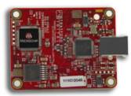
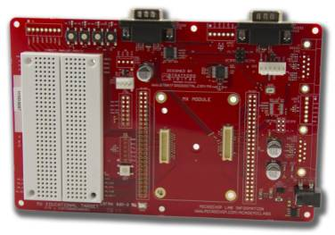

MX Series Modules and Target Board
Turnkey Lab Solution Featuring:
  PIC24FJ256GB110 MCU
  Comes with lab manual, labs and solutions
  www.microchip.com/academiclabs
  Integrated Programmer/Debugger to further reduce costs
  $165 USD on mD

Slide 22
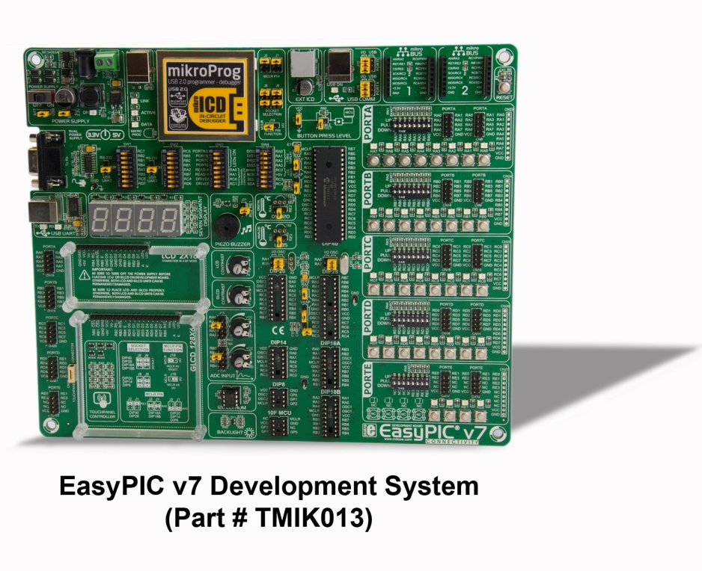

EasyPIC v7 Development System
Supports over 250 8-bit PIC MCUs
Accepts 8 to 40-pin DIP
Comes with PIC18F45K22
Integrated programmer/debugger
$149 USD on mD

Slide 23
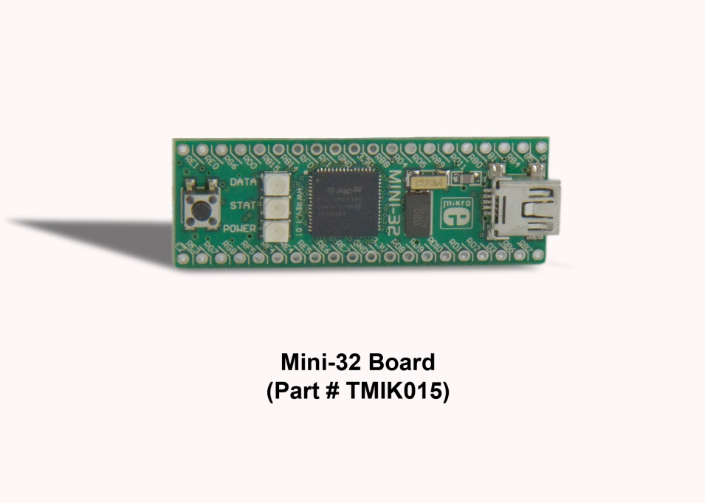
Mini-32 Board
PIC32MX534F064H
Pin Compatible with PIC16F887
Preprogrammed with HID Bootloader
$25 USD on mD

Slide 24
Getting Started

Slide 25
Academic Program
Support Resources
Notes:
25
25

Slide 26
Contact Us
Marc McComb
(480)792-4391
Academic@microchip.com
Visit us online at www.microchip.com/academic
  Portal to Academic-Related resources
  Download our Academic Program brochure
  And more!

Slide 27
Thank You!

